Slide 1
Creating a new app
Using Android Studio

Slide 2
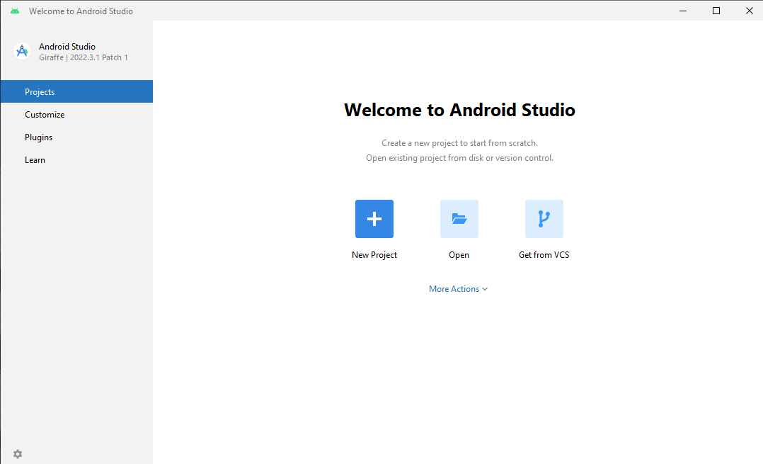
Starting a new project
Open Android Studio
In the list of software from the start menu if remoting in to N533 machines.
Click the New Project Button

Slide 3
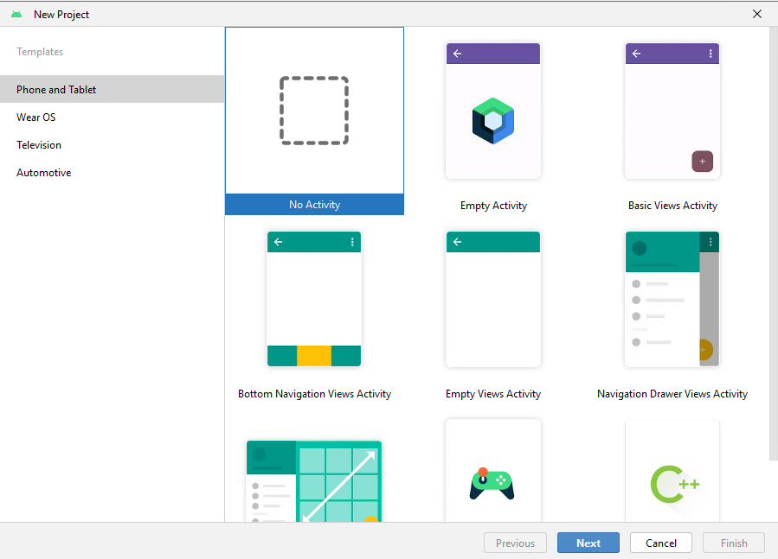
Types of Activities
Android Studio comes with various types of predefined Activity templates.
Let’s keep things simple and use No Activity in our labs.

Slide 4
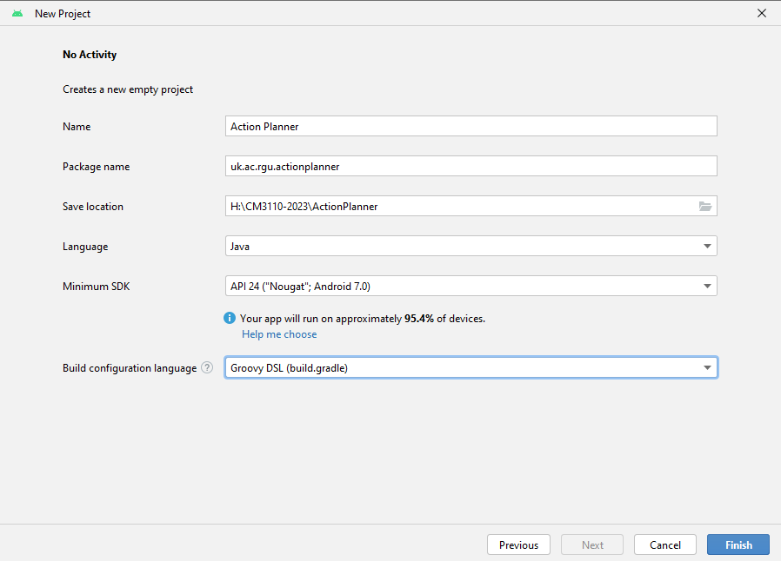
Setting up a new project: name, package
Tip: My Application is not a good app name
Tip: com.example is not a good package name, don’t use it!
Packages are used in Java to group related classes. More at W3Schools

Slide 5
Setting up a new project: save location
Select where your project will be saved.
This is where I keep my git repos from my H:\ drive.

Slide 6
Setting up a new project: language
We are not using Kotlin, change this to Java.

Slide 7
Setting up a new project: min API level
Let’s talk sweet treats.
Click here for detailed info about each level

Slide 8
Setting up a new project: Build Config language
Should be ok to leave at default; or change to Groovy DSL for consistency with examples

Slide 9
Android versions
You are probably familiar with Android version names: Ice Cream Sandwich, KitKat, Oreo, Pie, Android 10
Each version has a number: 4.0, 4.4, 8.0, 9.0, 10
Each version of Android came with its own API.
Each API is defined in terms of its API Level: 14-15, 19-20, 26-27, 28, 29

Slide 10
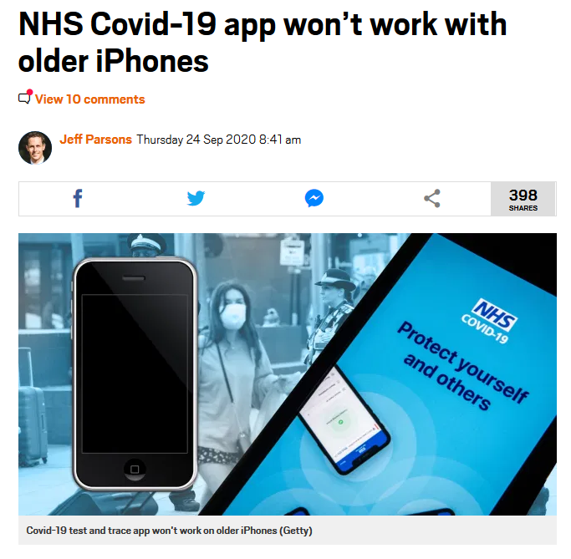
Why do we care?

Slide 11
Android APIs
We develop and compile our code in Android Studio using an Android SDK (version 11, level 30 in the lab)
We have to specify a minimum API level, which is the minimum API level the app is able to run on. We can go back as far as API Level 21 with our SDK.

Slide 12
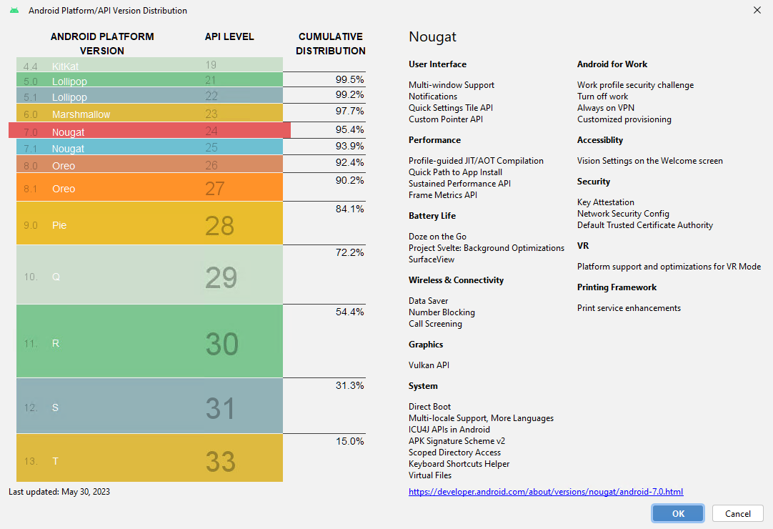

Slide 13
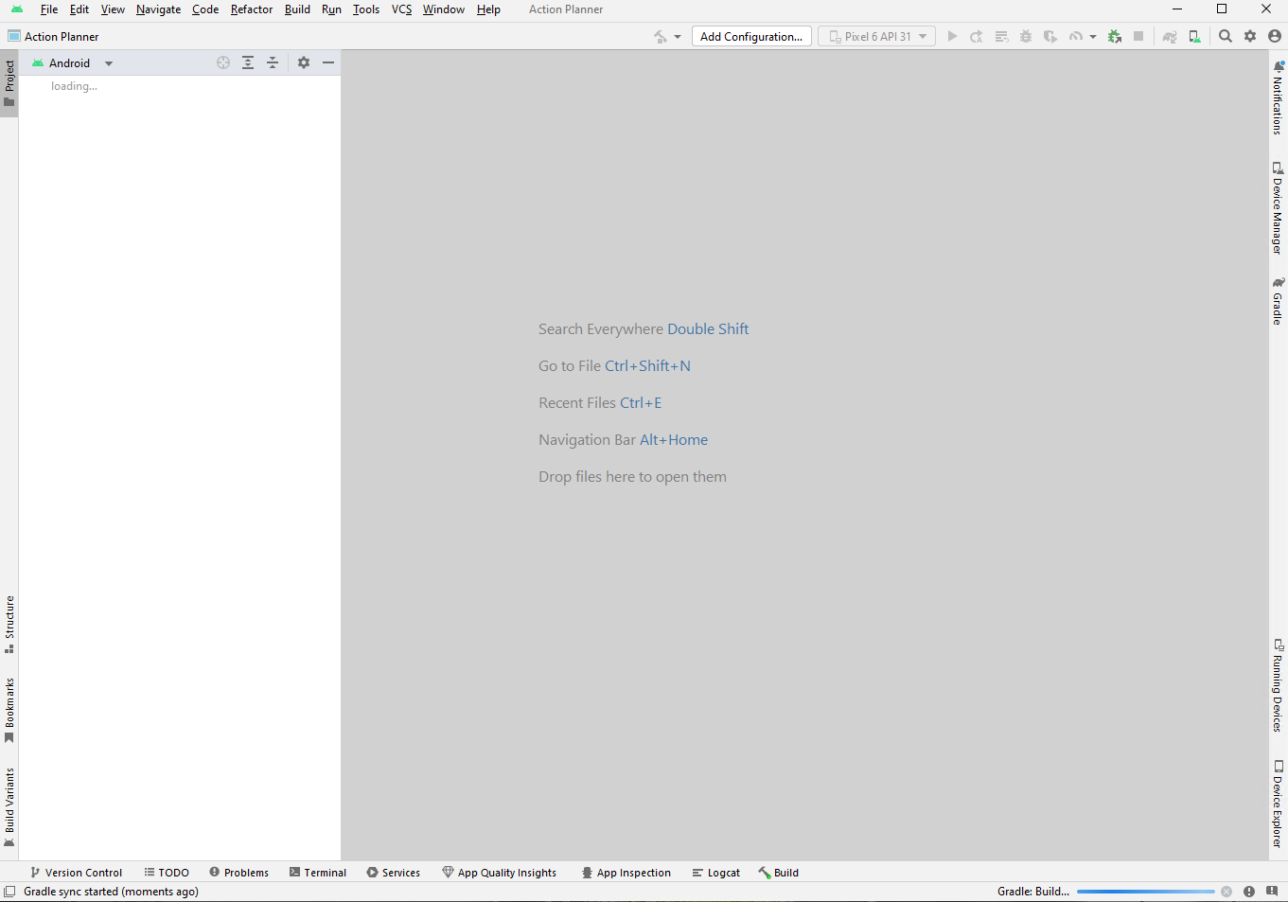
Success, a new project ready to go

Slide 14
Adding a New Activity

Slide 15
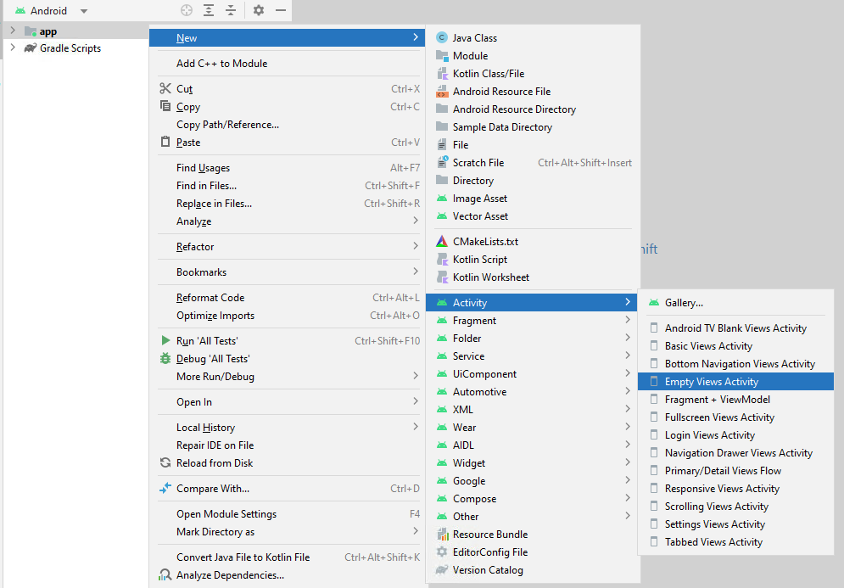
Activities
In order for the app to do be useful, we need to define one of more Activity.
Right click on the
Then select “Empty Views Activity”

Slide 16
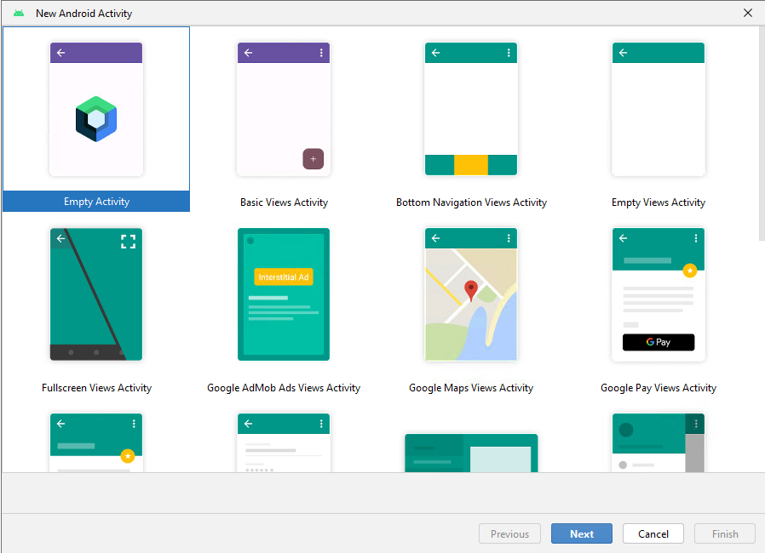
Activity templates
Various “quick start” templates for common types of activities.
We’ll work with Empty Activity, to give us complete control.

Slide 17
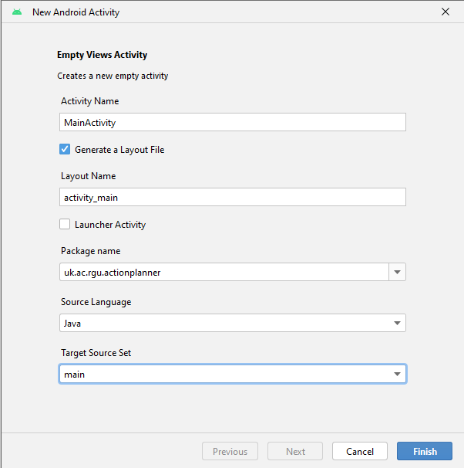
Creating the activity

Slide 18
Creating the Activity
Give the Activity a name related to its purpose
MainActivity as historically been used as the “first” activity to launch when the app runes.

Slide 19
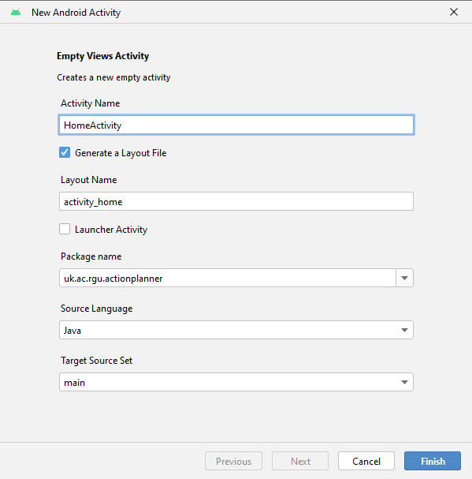
Naming the Activity
Give the Activity a name related to its purpose
Note how the Layout Name changes based on the Activity Name. The activity_home will be the XML layout file for this Activity’s UI

Slide 20
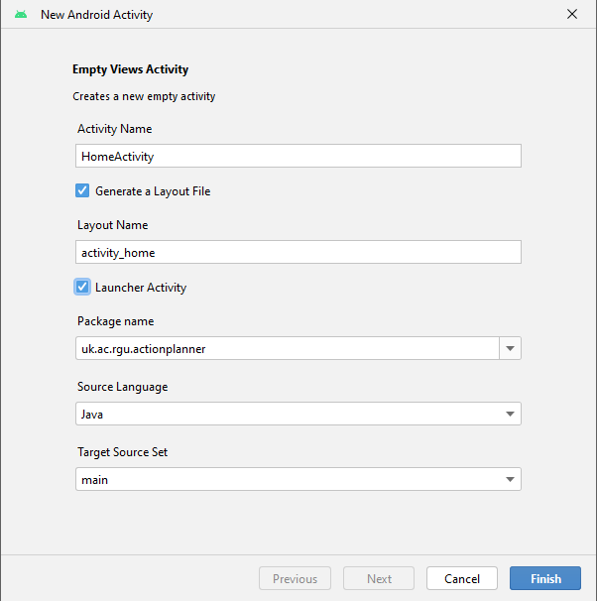
Launcher activity?
If this Activity should be loaded when the app is launched (opened), then check the “Launcher Activity” box

Slide 21
Others
The package name should be a package within your app.
Set the Source Language to Java
Set the Target Source Set to main
Then click finish

Slide 22
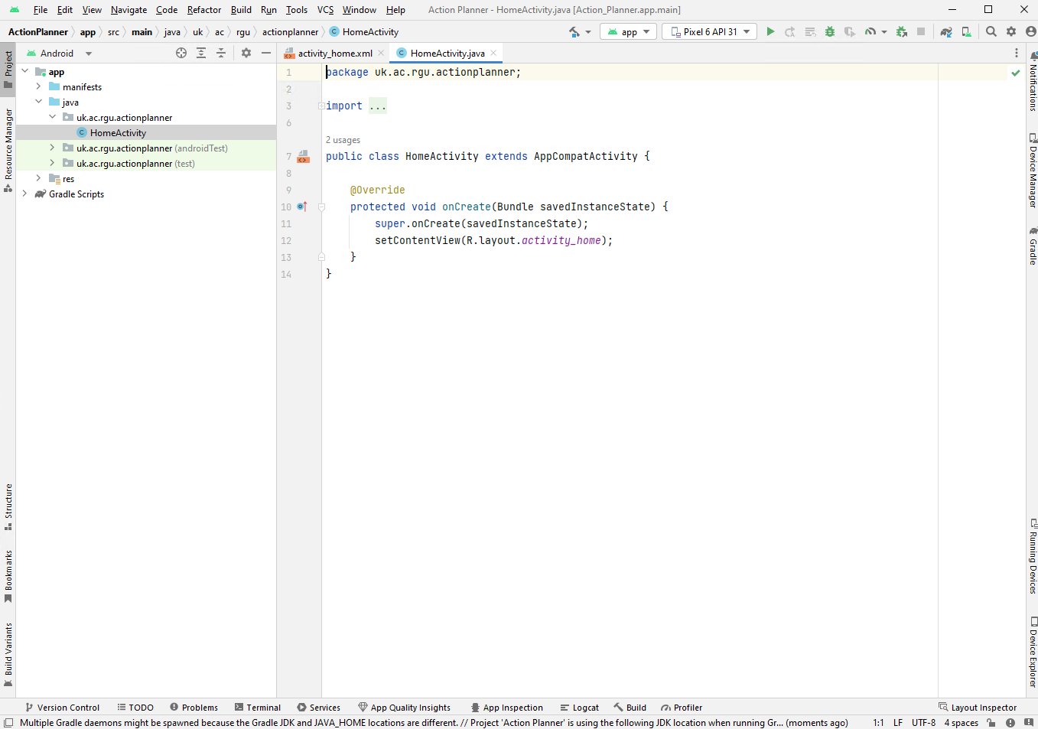
Now we’re ready….

Slide 23
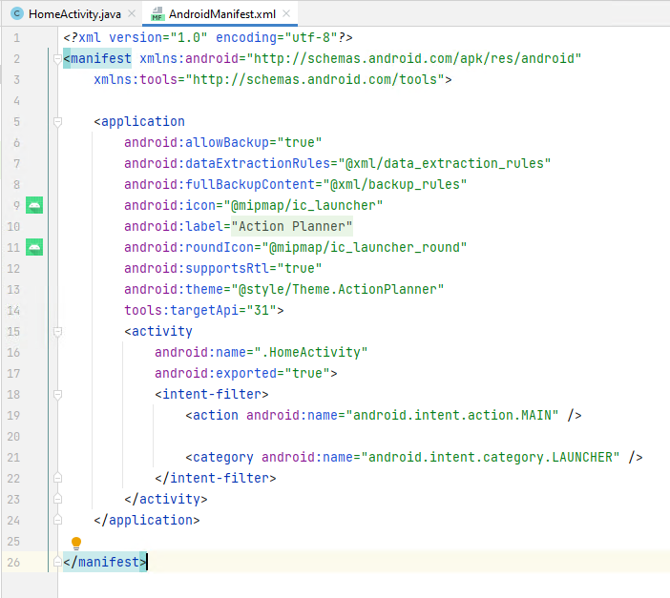
Launcher Activity
AndroidManifest.xml lists all of the Activities (and other things) about the app.
Including the MAIN activity (i.e. the one to be launched)

